Slide 1


Social Brand Monitor: See Your Product Reviews & Compare Competitors
Prepared by :- Hitesh Jangir

Slide 2
Technology Stack
This project was built using a modern, full-stack combination of technologies for the frontend, backend, database, and machine learning components.
Frontend
Backend
React: Interactive user interfaces.
FastAPI: Fast Python web framework.
React Router: Client-side navigation.
BeautifulSoup: Web Scrapping.
Axios: HTTP requests to API.
Simple JWT: Secure token-based authentication.
Database
Machine Learning
MongoDB: Flexible NoSQL document database.
Yolo: Training models.

Slide 3




What Social Brand Monitor Does
Our Social Brand Monitor is an AI-powered platform designed to cut through the noise, providing actionable insights from the vast ocean of online data.
Real-time Collection
AI-Powered Sentiment
Aggregates reviews and mentions from social media, blogs, forums, and major review sites instantly.
Analyzes sentiment (positive, negative, neutral) to provide nuanced insights into public perception.
Competitor Tracking
Visual Dashboards
Monitors competitor brands for benchmarking and helps refine your market strategy.
Offers intuitive dashboards showing mention volume, reach, and trending topics at a glance.

Slide 4
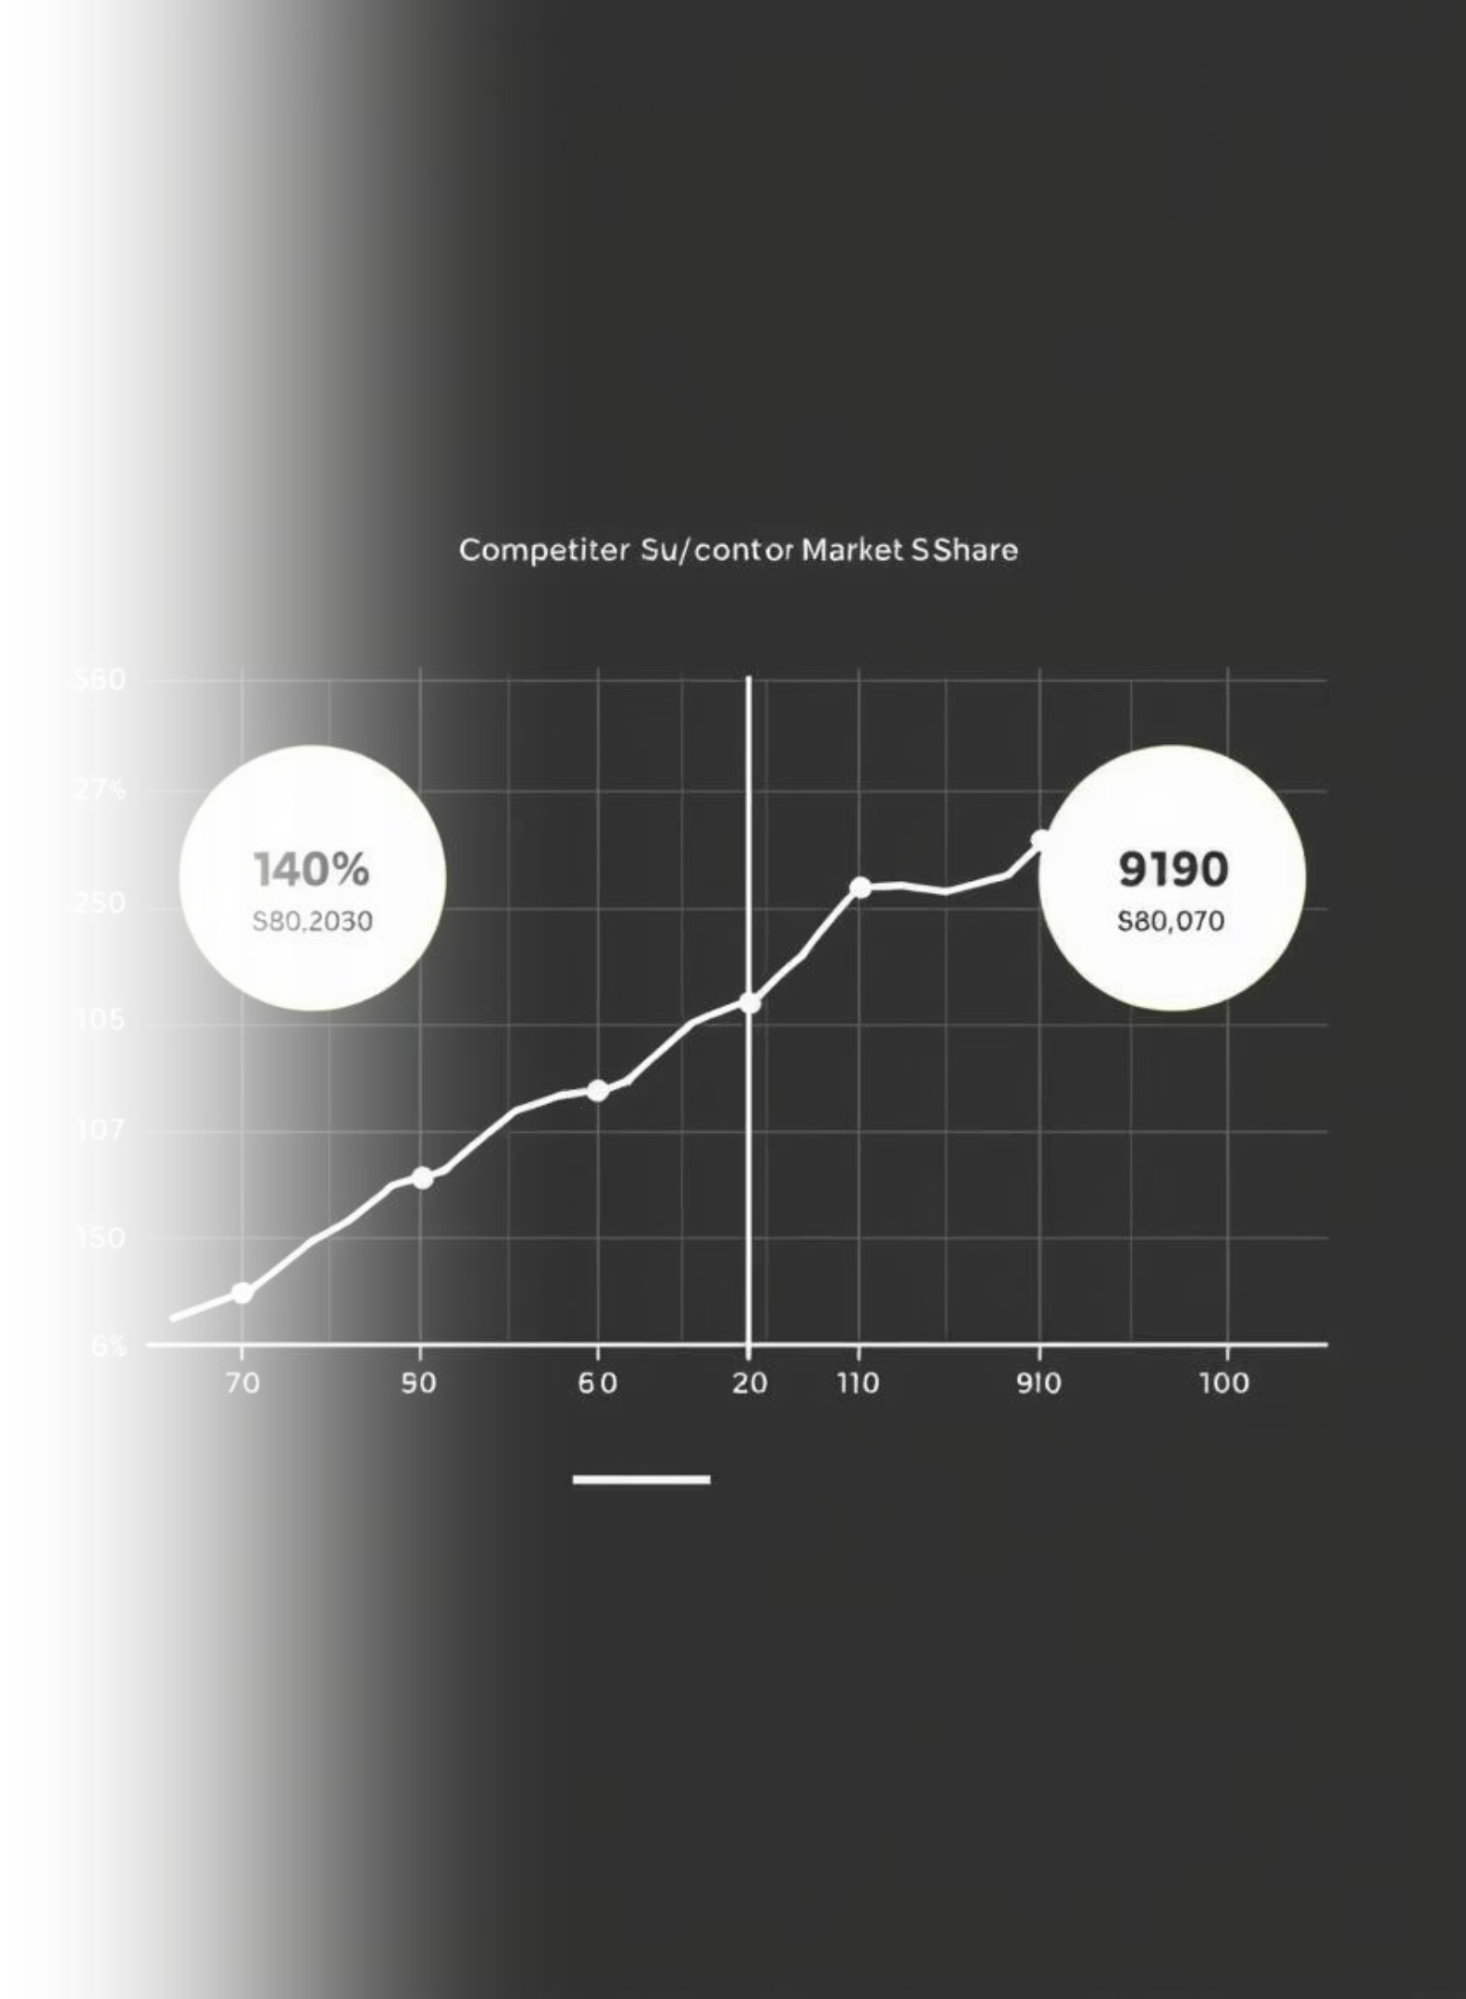
Key Features & Benefits
Sentiment Analysis
Competitor Comparison
Understand how customers truly feel about your product with granular insights into positive, negative, and neutral feedback.
Benchmark your brand's performance against rivals, identifying strengths and weaknesses in real time.
Influencer Identification
Custom Reports
Discover key voices and discussion leaders shaping your brand’s perception and engage them effectively.
Tailor insights for diverse stakeholders with branded, easy-to-understand visuals and data exports.

Slide 5



Real-World Impact: Case Snapshot
Crisis Response
Users report improved crisis response by detecting negative reviews early, preventing escalation.
Enhanced Engagement
Companies using competitor tracking achieve 15% higher engagement by adapting strategies faster.
Boosted Loyalty
AI-powered alerts enable proactive customer engagement, leading to significant boosts in brand loyalty.
These tangible results underscore the power of data-driven insights in today's competitive landscape.

Slide 6
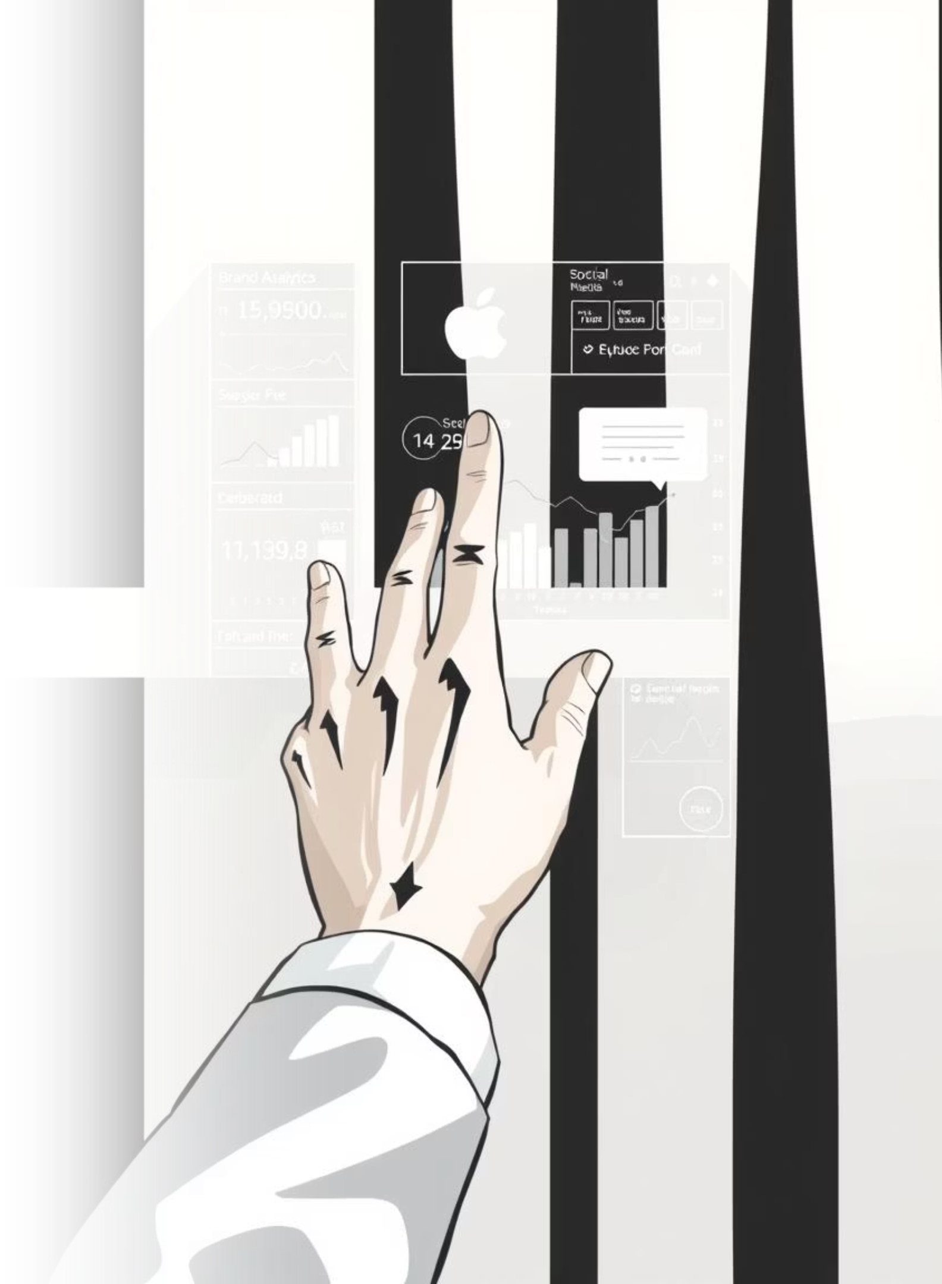
Future Scope:-
Multimodal Analysis
Advanced Sentiment & Emotion Detection
Fake News & Competitor Analysis
Geographical Insights

Slide 7
Thank You

